Slide 1
TTRL:Test-Time Reinforcement Learning

Slide 2
Pseudo label
TTT:Test-Time training
RL

Slide 3
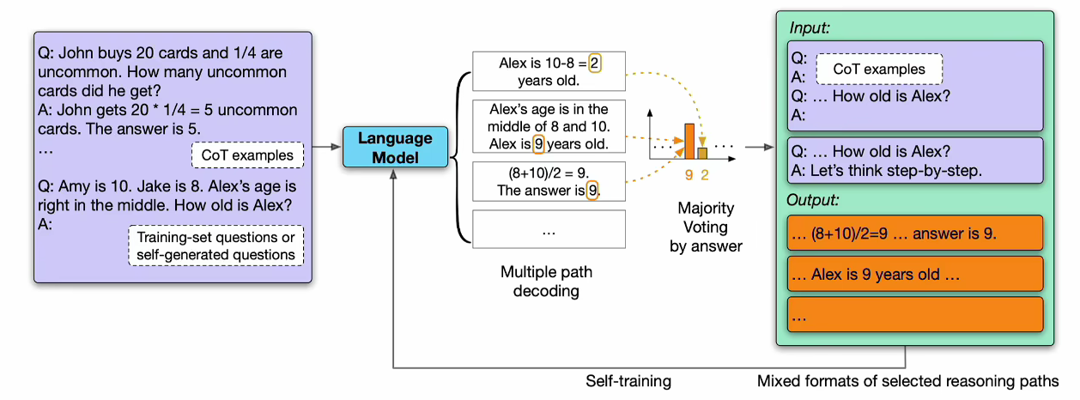

Slide 4

Model collapse(nature)

Slide 5
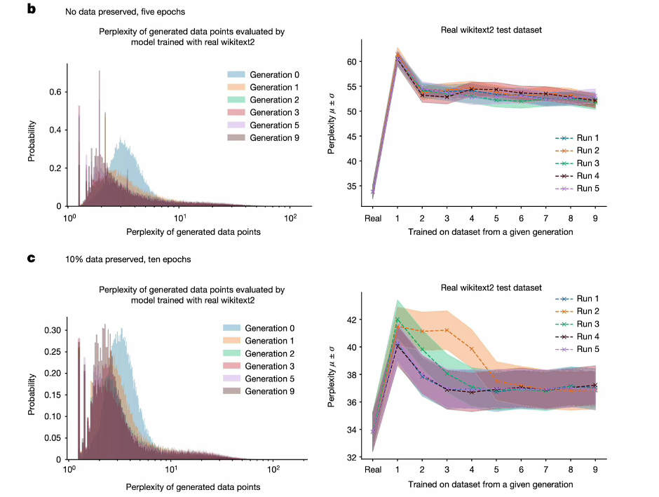

Slide 6
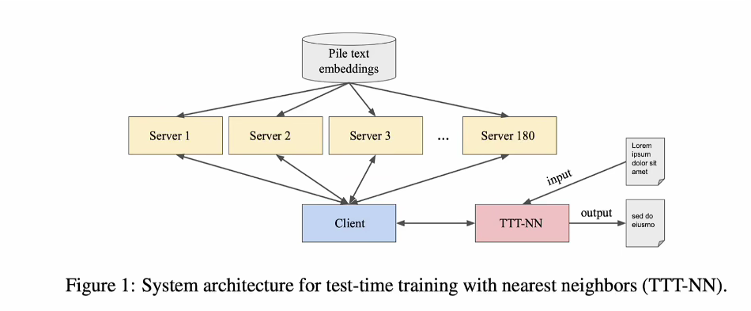
ICLR

Slide 7
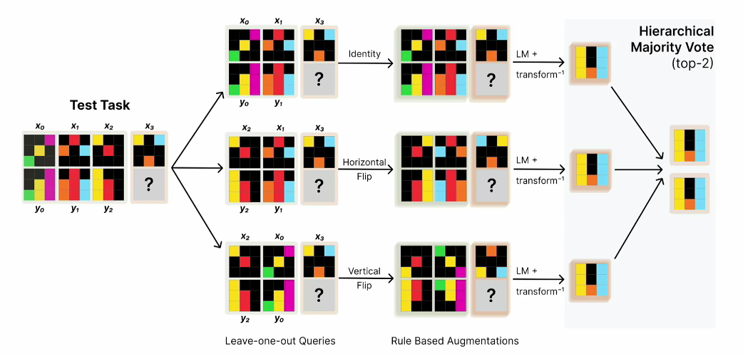
MIT

Slide 8
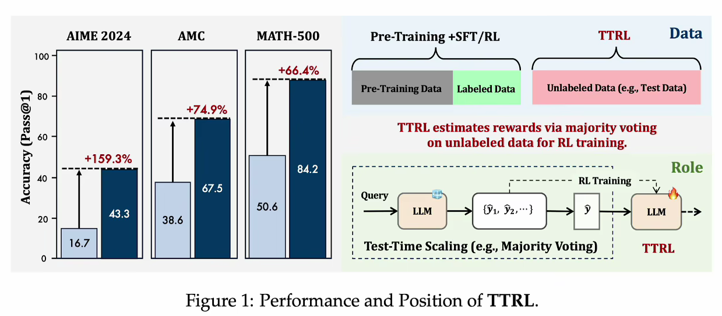

Slide 9
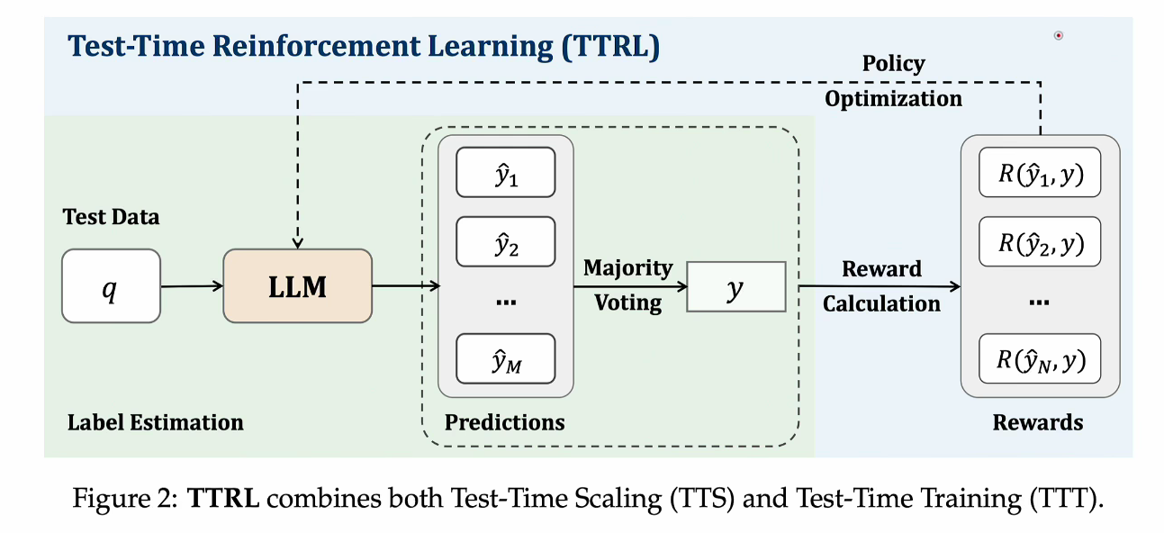

Slide 10


Slide 11
